Slide 1
Linux系统简介
Notes:
什么样的技术，有什么特点，应用在哪些领域

Slide 2
本章
UNIX与Linux发展史
Linux系统安装
远程登录管理工具

Slide 3
Window Server 2008
——再造新一代IT基础架构

Slide 4















微软对客户的承诺
Notes:
Title: Microsoft’s Promises to You
Talking Points: Today’s business is faced every day with the challenges of managing costs while improving flexibility and agility to drive new business opportunity – all this amidst an increasingly complex IT landscape. The Dynamic Systems Initiative (DSI) is Microsoft's long-term strategy to dramatically reduce the complexity and TCO of developing, deploying, and managing applications so an IT staff can focus on delivering new business value. DSI provides a model-driven approach together with a complete, integrated set of technology solutions that put IT in control over their environment.
No matter what business you are, it’s people who drive success. Enable your people with the right tools, information and resources, and you enable your business. Today is about a specific set of people in your organization – your IT department. It’s about stepping back and thinking about what it is they need to be successful and have the greatest impact in your organization.
So the question is: What role does software play in a people-ready business?
Businesses don’t garner insights or make decisions. Businesses don’t close deals, invent new products, or find new efficiencies. People do.
Companies excel when they empower their people to drive the business forward. Strategies, organization, motivation, and leadership all set the stage for business success. But to see results, you also have to give your people the right tools, information, and opportunities—because success ultimately comes down to your people. We call a business that fosters a winning environment a “people-ready business.”
Software is instrumental to the people-ready business. Software is increasingly how we harness information, the lifeblood of business today. Software enables people to turn data into insight, transform ideas into action, and turn change into opportunity.
Microsoft has laid out its promises to IT Pros and Developer teams. Our core focus revolves around these four key areas and on taking a holistic approach to delivering against them in a way that enables IT Pros and Developer teams to be successful in their roles across the IT lifecycle.
So, whether it’s the folks who design and build your solutions; those that deploy, configure and operate your systems; your teams responsible for maintaining the security of your network; or staff supporting your end-users and ensuring they have what they need to communicate and access resources each day, we believe it’s our job to help make the broad spectrum of IT people in your organization as successful as possible, enabling them to add business value across your organization.

Slide 5
课程内容
Windows Server 2008 系统部署
Windows Server 2008 系统管理
Windows Server 2008 网络管理
Windows Server 2008 安全管理
Windows Server 2008 活动目录管理
Windows Server 2008 Web服务器管理
Windows Server 2008 虚拟化管理

Slide 6
Window Server 2008
—— 系统部署

Slide 7














部署技术的演进
WDS 服务器
Windows安装光盘片
参考计算机
目标计算机
.wim档
.wim档
WINNT32
Answer Files
RIS服务器
RIS客户端
部署的共享文件夹

Slide 8



部署的环境
DHCP 服务器
DNS 服务器
ADDS 服务器
WDS 服务器

Slide 9
从RIS的变更
能部署Windows Vista和Windows Longhorn Server
支持Windows预安装环境(Windows PE)
WIM格式的原生支持
能使用多址传播传送数据和镜像
能在独立服务器上使用多址传播传送数据和镜像(安裝Transport服务器角色)

Slide 10
从RIS的变更( Cont.)
可延伸且高性能的PXE服务器组件
新的开机功能表格式BCD
MMC管理控制台界面(GUI)
Notes:
Remote Installation Service

Slide 11
从Windows Server 2003WDS的变更
能使用多址传播传送数据和镜像
能在独立服务器上使用多址传播传送数据和镜像(安裝Transport服务器角色)
不再支持RISETUP镜像或OSChooser画面
增强TFTP服务器
支持x64(EFI)的网络开机

Slide 12






独立Transport服务器
DHCP
DNS
ADDS
多址传送
Transport服务器
Notes:
12

Slide 13




部署的目标
Transport 服务器
OS镜像
数据文件
MP3 档

Slide 14

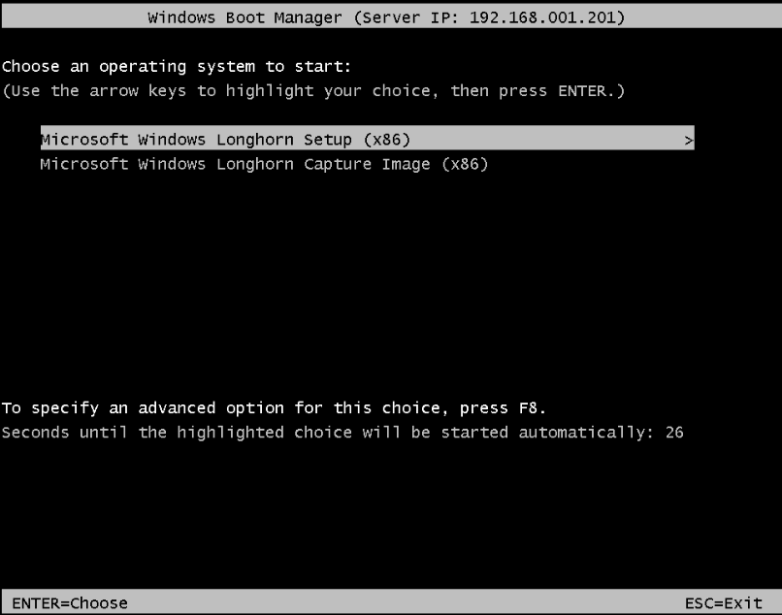
安装操作系统

